Slide 1
Heterogeneous Graph Attention Network
Source : WWW 2019
Advisor : JIA-LING KOH
Speaker : YI-CHENG HUNG
Date:2019/05/06

Slide 2
Outline
Introduction
Method
Experiment
Conclusion

Slide 3
Outline
Introduction
Method
Experiment
Conclusion

Slide 4
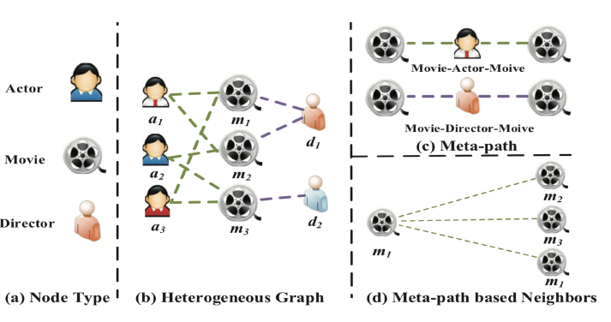
Introduction

Slide 5
Outline
Introduction
Method
Experiment
Conclusion

Slide 6
PRELIMINARY
Definition 3.1. Heterogeneous Graph

Slide 7
PRELIMINARY
Definition 3.2. Meta-path
Movie-Actor-Movie (MAM) and Movie-Director-Movie (MDM).

Slide 8
PRELIMINARY
Definition 3.3. Meta-path based Neighbors.

Slide 9
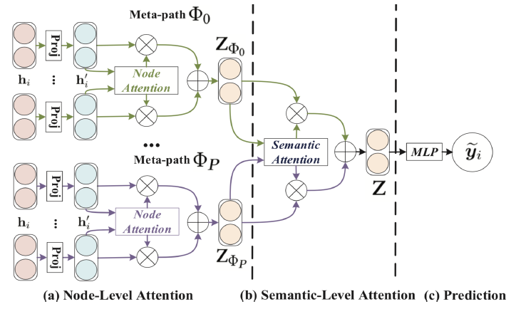
The overall framework of the proposed HAN.

Slide 10
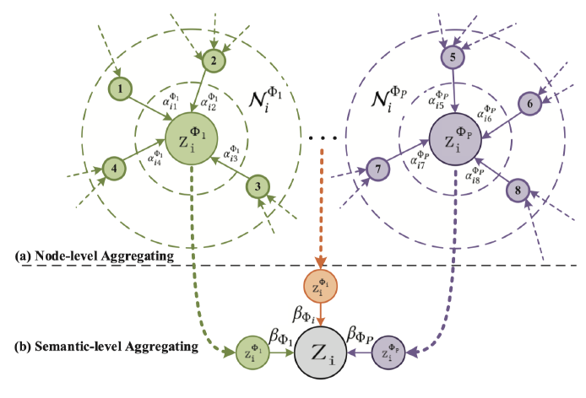
Node-level Attention

Slide 11
Semantic-level Attention

Slide 12
Algorithm

Slide 13
Outline
Introduction
Method
Experiment
Conclusion

Slide 14
Dataset

Slide 15
Qantitative results (%) on the node classification task.

Slide 16
Qantitative results (%) on the node classification task.

Slide 17
Qantitative results (%) on the node classification task.

Slide 18
Meta-path based neighbors of node P831 and corresponding attention values

Slide 19
Analysis of semantic-level attention.

Slide 20
Qantitative results (%) on the node clustering task.

Slide 21
Visualization embedding on DBLP

Slide 22
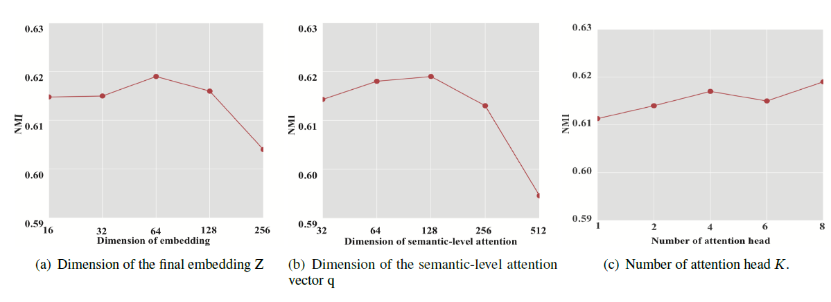
Parameter sensitivity of HAN

Slide 23
CONCLUSION
The proposed HAN can capture complex structures and rich semantics behind heterogeneous graph.
The proposed model leverages nodelevel attention and semantic-level attention to learn the importance of nodes and meta-paths, respectively.

